Slide 1
Billy's Goals
To do the most amazing thing he could think of:
Finalize the intro animation
Work on Town Assets and world objects
Work with game board creation
Time expectations:
      12 Hours

Slide 2
Billy's Accomplishments
Resolved several issues with Blender animation for the introduction
Completed the introduction... to be displayed in classroom theaters soon (April 30th). See Dane for ticket sales.
Developed psuedocode for how the gameboard information can be saved / reloaded

Slide 3
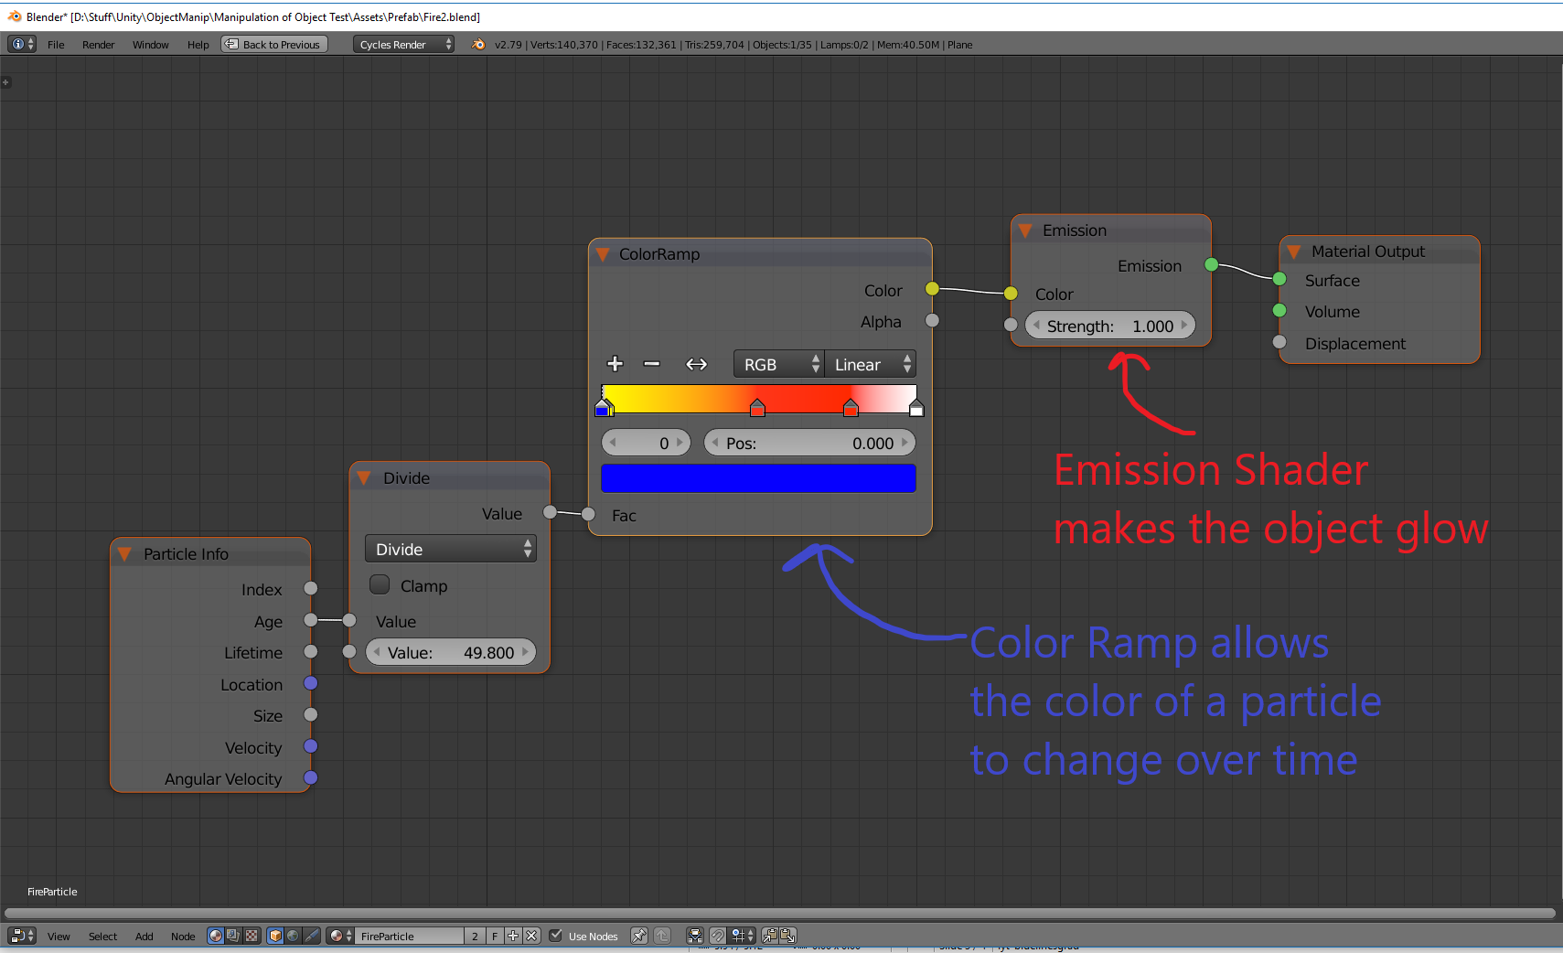
Billy's Learnings

Slide 4
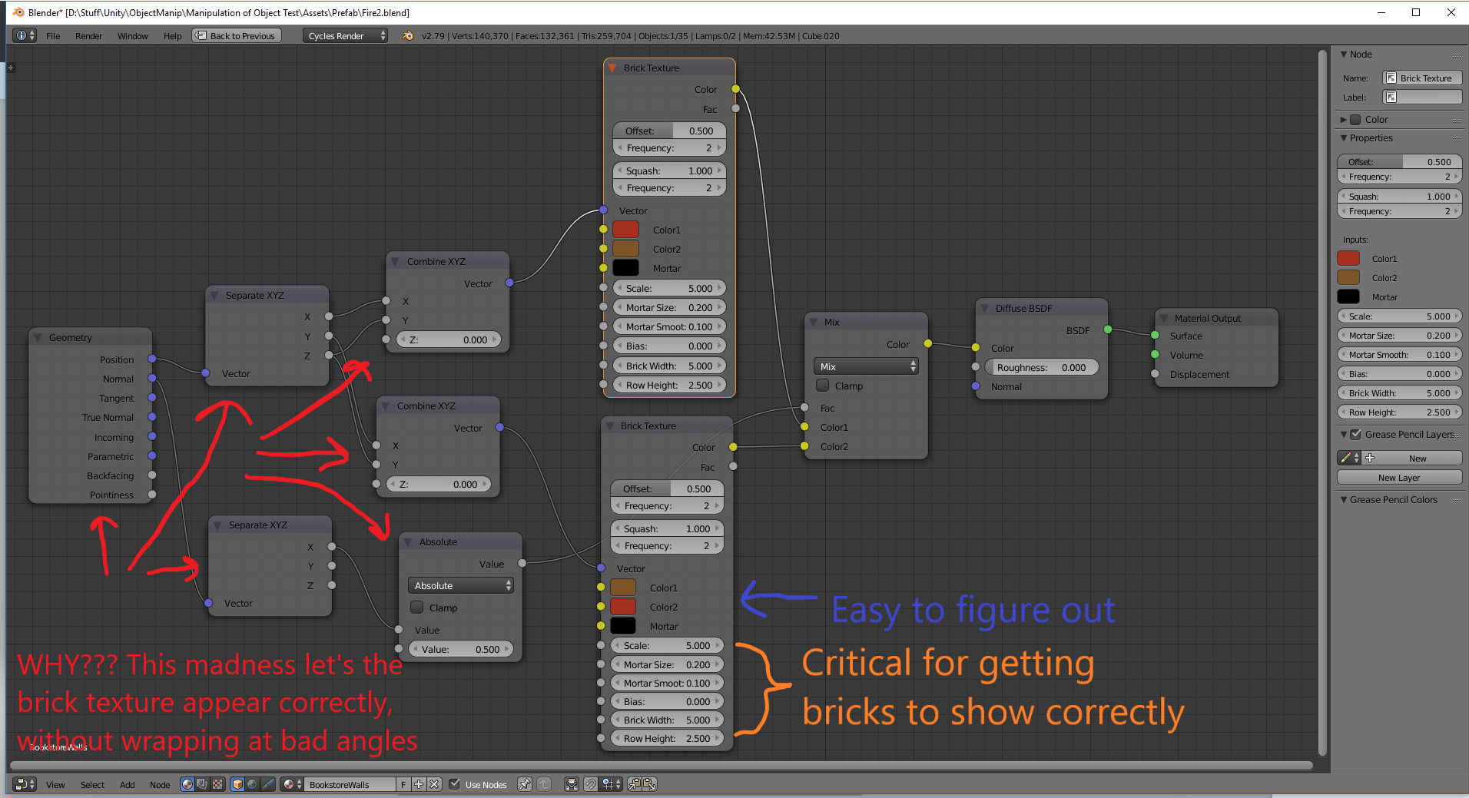
More Learnings

Slide 5
Billy's Accomplishments
Time spent:
Way. Too. Much.
  Close to 26 hours, including time to compile animations, then lament them not looking as good as I wanted (scene too dim, scene to bright, backwards body on a creature, etc.)
Not feeling good. Look for answers to questions on the class slack channel.

